Slide 1
Introduction to Computer Organization
Representing and Manipulating Data
CSTA Day 2
Rodrigo A. Obando

Slide 2
What is a System?
According to dictionary.com:
A group of interacting, interrelated, or interdependent elements forming a complex whole.
"system." The American Heritage® Dictionary of the English Language, Fourth Edition. Houghton Mifflin Company, 2004. 07 Nov. 2006. <Dictionary.com http://dictionary.reference.com/browse/system>

Slide 3
Computer Systems
A computer system is a particular type of system that its primary purpose is that of performing computations. Before the time of the electronic computers, a computer was a person that performed computations.
A computer system is composed of a Central Processing Unit (Control Unit and Arithmetic & Logic Unit), Memory and Input/Output subsystems.

Slide 4
Computer System Overview

Slide 5
Central Processing Unit (CPU)
The Central Processing Unit is composed of a Control Unit and an Arithmetic & Logic Unit.
The Control Unit controls the different components of the system and it is responsible for fetching, decoding and executing the instructions of a program.
The Arithmetic & Logic Unit is performs arithmetic and logical operations such as addition, division, comparison, etc.

Slide 6
Control Unit (CU)
The Control Unit is the part of the CPU that fetches (reads) instructions from memory.
Each instruction is decoded to determine what exactly it is supposed to do.
Once decoded, each instruction is executed.
The cycle continues until the system is powered down.

Slide 7
Fetch, Decode, and Execute Cycle

Slide 8
Arithmetic & Logic Unit (ALU)
The Arithmetic & Logic Unit (ALU) performs the arithmetic operations as well as the logical operations.
The arithmetic operations include addition, subtraction, multiplication and division.
The logical operations are commonly used to compare values and determine whether they are greater, lesser or equal to one another.
These operations are normally carried out with registers that are part of the CPU.

Slide 9
ALU and Registers

Slide 10
Storage (Memory)
The Storage subsystem is a unit that is capable of retrieving and saving instructions as well as data.
There are two main types of storage: Primary Storage and Secondary Storage.
Primary Storage is the memory that is immediately available to the CPU and it is normally fast (RAM or Random Access Memory).
Secondary Storage is indirectly available to the CPU and it is typically slower. (Hard disks, tapes, etc.)

Slide 11
Input/Output (I/O)
The I/O subsystem is critical since it is the one responsible for receiving and sending data to the outside world. The computer would be useless to us without this system.
There are many devices that can be used for input and/or output. Typical input devices are keyboards, mice, and graphics tablets. Typical output devices are screens and force-feedback joysticks.

Slide 12
Number Systems
Everything that the computer handles is stored in the form of numbers. The numbers are meaningless by themselves and we need to associate significance so that they can be useful.
We associate symbols with the concept of a number and, for example, the number three is represented with the symbol 3. The symbol is not the number three but a placeholder for its concept.

Slide 13
Decimal Number System
We use the decimal number system in our daily lives. It is called the decimal system because it uses 10 distinct symbols: 0, 1, 2, 3, 4, 5, 6, 7, 8, and 9.
We can represent any number by combining these symbols. The number three million seven hundred forty eight thousand and three hundred twenty one can be represented with 3748321.

Slide 14
Decimal Numbers in Computers
If we want a computer to use the decimal number system we need to have devices capable of storing, retrieving and manipulating ten values or primitive symbols.
Although possible, this system would be subject to error and deterioration and would imply a short lifetime.

Slide 15
Binary Number System
What is the simplest number system we could use?
We could use the unary number system but it does not lend itself to simple and speedy manipulation in terms of arithmetic and other operations.
We use the Binary Number System inside the computers. This system only has two symbols, 0 and 1.

Slide 16
Binary Number System in Computers
Besides the physical (electronics) reasons for using binary there are also mathematical advantages.
Boolean Algebra is an area of mathematics that studies the properties of the binary system. It provides us with an excellent foundation not only to design the electronic parts of a computer but also to develop algorithms to expedite computations.

Slide 17
Examples of Binary Numbers and Some Operations
34₁₀ = 100010₂
3₁₀ = 11₂
3748321₁₀ = 1110010011000111100001₂
23₁₀ + 74₁₀ = 97₁₀
10111₂ + 1001010₂ = 1100001₂
7480₁₀ / 10₁₀ = 748₁₀
1000010110₂ / 10₂ = 100001011₂

Slide 18
Coding Information
We usually assign meaning to different symbols. As long as we agree on what symbol has what meaning we are able to communicate with each other using those symbols.
We can use 0 and 1 in place of no and yes. They could also mean closed and open, agree and disagree, bad and good.

Slide 19
Coding Text
One of the very useful coding schemes we used with computers is the coding of text characters.
The ASCII code is widely used throughout the computing world. Every character has a binary code and we can represent text by using binary numbers and interpreting them as characters.
ASCII is a subset of UNICODE which is used to encode international symbols.

Slide 20
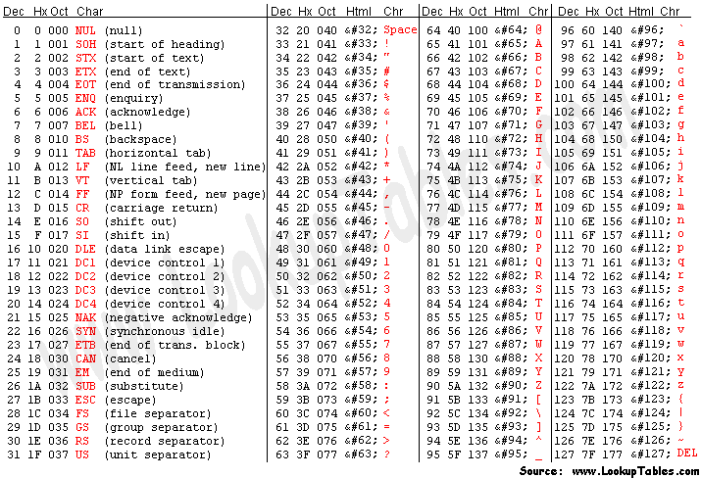
ASCII Table

Slide 21
Text, Images and Sound
In the same way that we code text we can code virtually anything.
An image is basically a rectangle of dots and each dot is of a certain color. The color of these dots can be represented by a number.
Sound may be represented as a sequence of numbers indicating how to move a speaker.

